Slide 1
Lead Scoring Assignment
BY
Anand Pratap,
Amit Maithani,
Abhijit Takalkar

Slide 2
Problem Statement
X Education is an organization that provides online courses for industry professionals and wants to select the most promising leads that can be converted into paying customers.
The company markets its courses on several websites and search engines like Google. Leads come through numerous models like emails, advertisements on websites, and Google searches. X Education gets lots of leads, but the conversion rate is very poor.
To make this process more efficient, the company wishes to identify the most potential leads, also known as ‘Hot Leads’.

Slide 3
Goals of Case Study
The company requires model to be built for selecting most promising leads.
Lead score to be given to such that it indicates how promising the lead could be. Higher the score, higher the chances of convert the lead into paying customer.

Slide 4
Import Given Data
Data Preparation and Cleaning
Exploratory Data Analysis of Data
Feature Scaling
Splitting Data into Train and Test Datasets
Building Regression Model based on Datasets
Calculate Lead Score
Evaluating the Regression Model by using different metrics - Specificity and Sensitivity or Precision and Recall.
Applying the best model in Test data based on the Sensitivity and Specificity Metrics.
Strategy

Slide 5
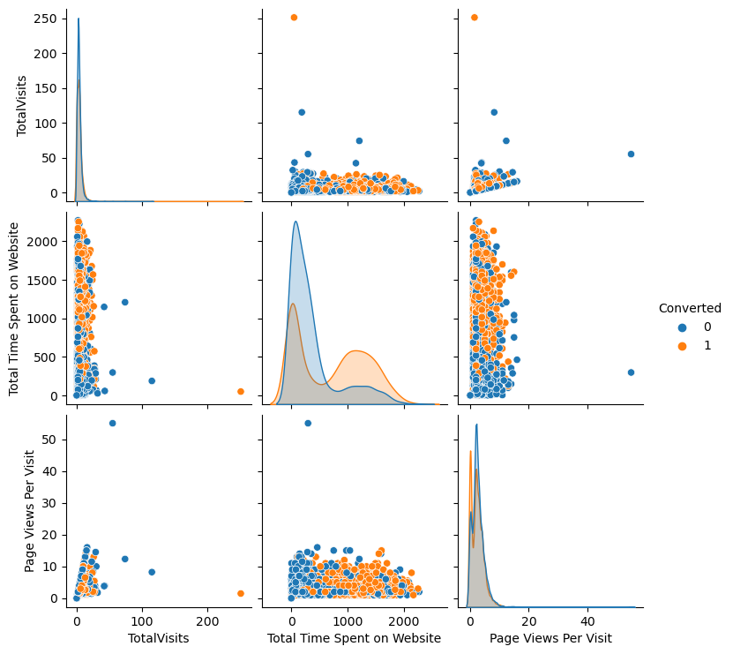
Data Modeling & EDA
P 1

Slide 6
Continue
P 2

Slide 7
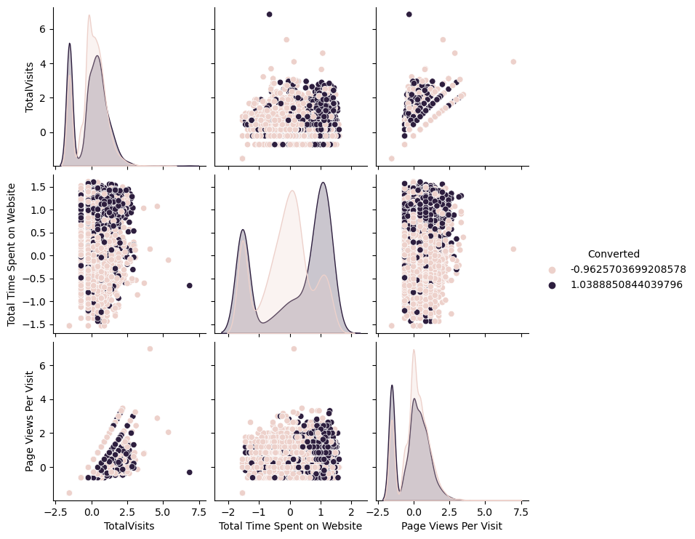
Continue
P 3

Slide 8
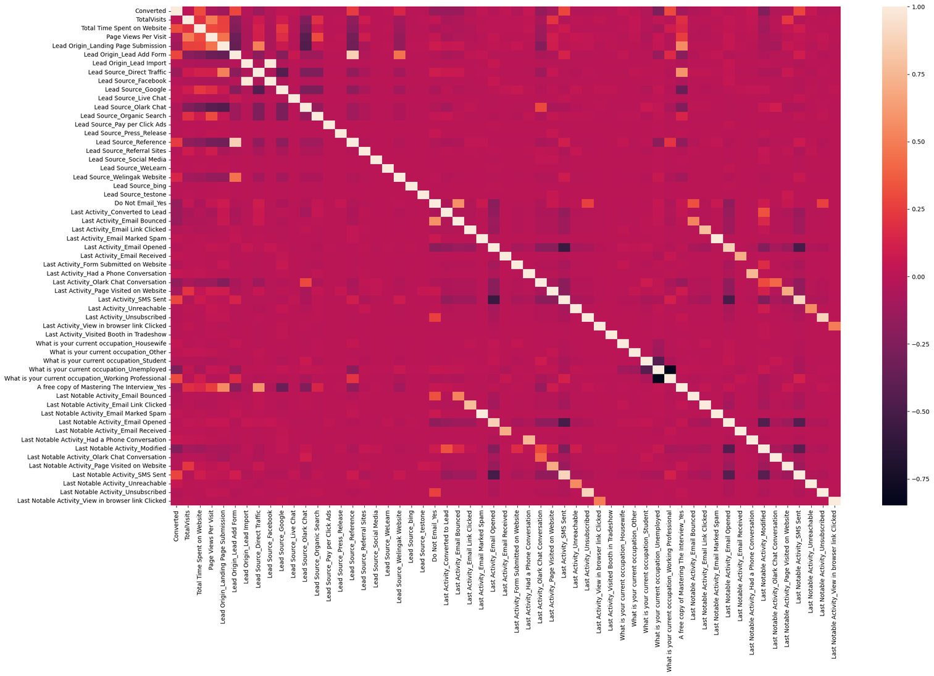
Correlation

Slide 9
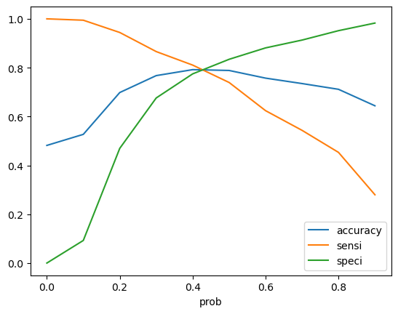
Model Evaluation
Accuracy - 81%
Sensitivity - 80 %
Specificity - 82 %
False Positive Rate - 18 %
Positive Predictive Value - 74 %
Positive Predictive Value – 86%

Slide 10
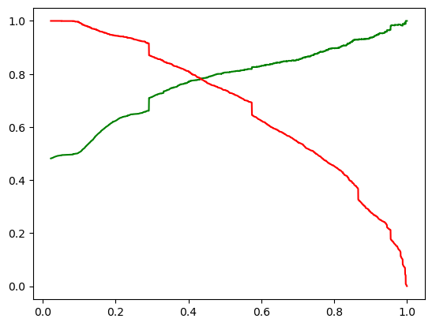
Model Evaluation
Precision - 79 %
Recall - 71 %

Slide 11
Conclusion
Leads are generated at the top (initial stage), but only a few become paying customers at the bottom. In the middle stage, you need to nurture the potential leads well (i.e. educating the leads about the product, constantly communicating etc.) in order to get a higher lead conversion. First, sort out the best prospects from the leads you have generated. 'Total Visits' , 'Total Time Spent on Website' , 'Page Views Per Visit' which contribute most towards the probability of a lead getting converted. Then, you must keep a list of leads handy so that you can inform them about new courses, services, job offers and future higher studies. Monitor each lead carefully so that you can tailor the information you send to them. Carefully provide job offerings, information or courses that suit best according to the interest of the leads. A proper plan to chart the needs of each lead will go a long way to capturing leads as prospects. Focus on converting leads. Hold question-answer sessions with leads to extract the right information you need about them. To determine whether the leads will enroll in online courses, make further inquiries and appointments.

Slide 12
Thank You

